Slide 1
Lecture 10
Pandas in Action

Slide 2
Learning Objectives Today
Recap
Search, Query on DataFrame
Handling Missing Data
Handling Null Values
Hierarchical Indexing

Slide 3
Revision of Pandas Basic
Check Lecture10_Scripts1.ipynb

Slide 4
Extra Knowledge related to Previous Topics

Slide 5
Search an item
df.isin(['Mexico']).any()
#returns column name
df[df.isin(['Mexico'])].stack().index.tolist()
#Return coordinates of the matrix
Check Lecture10_Scripts1_2.ipynb

Slide 6
Query
df[df['Country'] == 'Mexico’]
df[(df['Units Sold'] >= 2000) & (df['Units Sold'] <= 3000)]
df[(df['Units Sold'] >= 2000) & (df['Units Sold'] <= 3000) & (df[' Manufacturing Price ']>=120)]

Slide 7
Pandas None vs NaN
Feature | None | NaN (Not a Number)
Data Type | NoneType | float
Behavior in Calculations | Usually errors | Propagates (often returns NaN)
Impact on DataFrame Type | May convert column to float | Stays as float
Checking for Missing Values | Not directly by np.isnan | Detected by isnull and isna

Slide 8
Fill Missing Value with 0
df = pd.read_csv('lecture10.csv')
df.fillna(0, inplace=True)
Df
# In case of only one column
df = pd.read_csv('lecture10.csv')
df['val1'].fillna(0, inplace=True)
df

Slide 9
isnull and notnull
Identify rows with missing values and no missing values
df[df['val2'].isnull()]
df[df['val2'].notnull()]
df[df[['val1','val2']].notnull().all(axis=1)]
Check Lecture10_Scripts2.ipynb

Slide 10
‘dropna’ Function for Handling Null Values
df = pd.read_csv('lecture10.csv')
df.dropna()
#Drop all the rows that contain null values

Slide 11
'fillna’ Forward-fill and Backward-fill
Filling the null values with previous row-value or next row-value
df = pd.read_csv('lecture10.csv')
print(df)
df.fillna(method='ffill',axis=0)
df.fillna(method='bfill',axis=0)

Slide 12
Remember
# Drop rows with any NaN
df.dropna(inplace=True)
# Drop rows only if all values are NaN
df.dropna(how='all', inplace=True)
# Drop columns with any NaN
df = df.dropna(axis=1)

Slide 13
Other Techniques for Handling Missing Data
Interpolating
Mean, Mode, Median
Check Lecture10_Scripts2.ipynb

Slide 14
Hierarchical Indexing
Multiple Column as Index
df = pd.read_csv('sample_data2.csv')
df.head()
df_ind = df.set_index(['Country', 'Type', 'Product'])
df_ind
Check Lecture10_Scripts3.ipynb

Slide 15
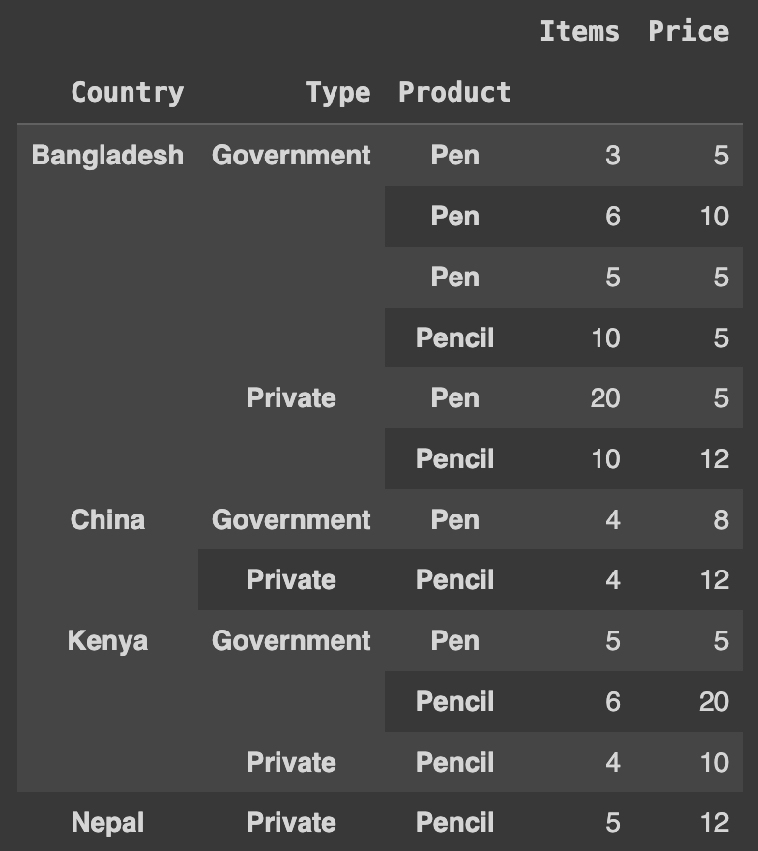
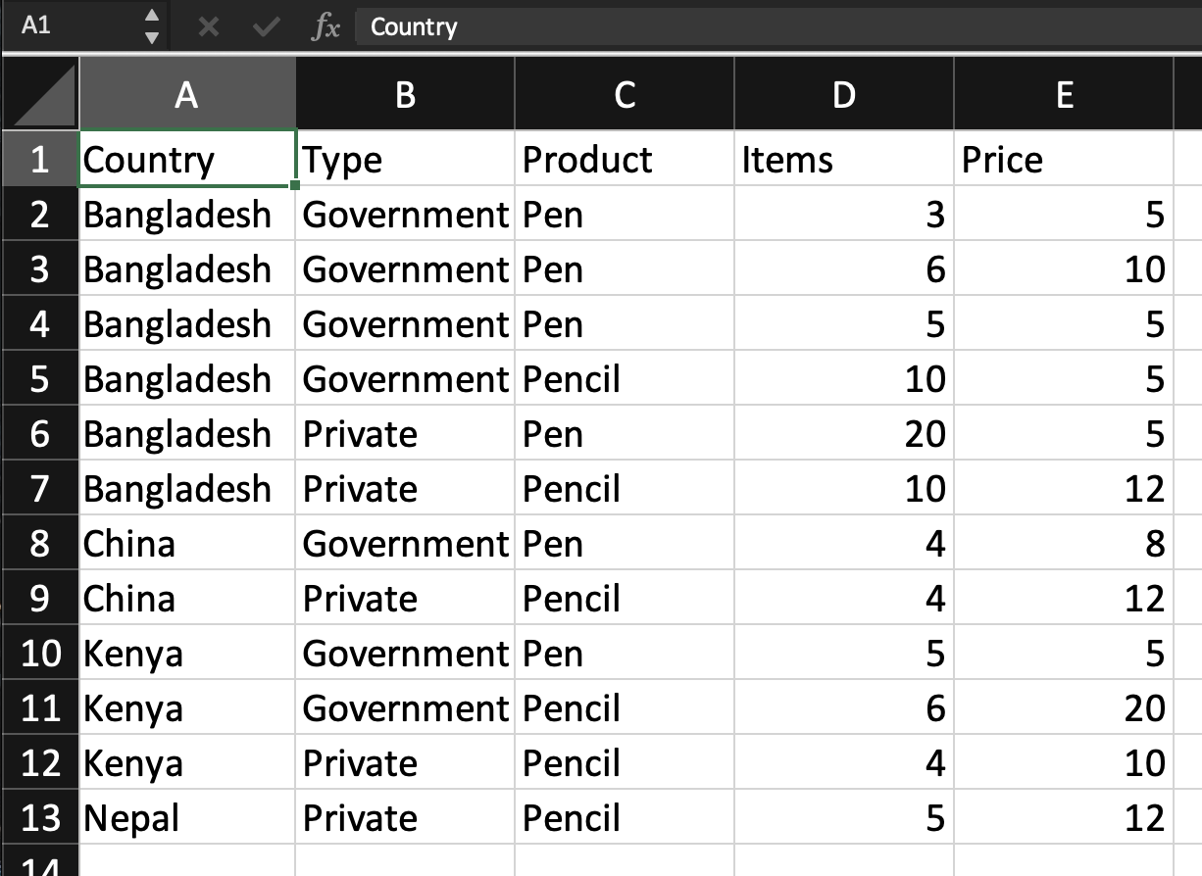
Hierachical Indexing

Slide 16
Access
df_ind_sorted.loc['Bangladesh','Government','Pen’]
df_ind_sorted.loc['Bangladesh','Government']
df_ind_sorted.loc['Bangladesh']
df_ind_sorted.loc['Pen']

Slide 17
Access
idx = pd.IndexSlice
df_ind_sorted.loc[idx['Bangladesh', ['Government', 'Private']], :]

Slide 18
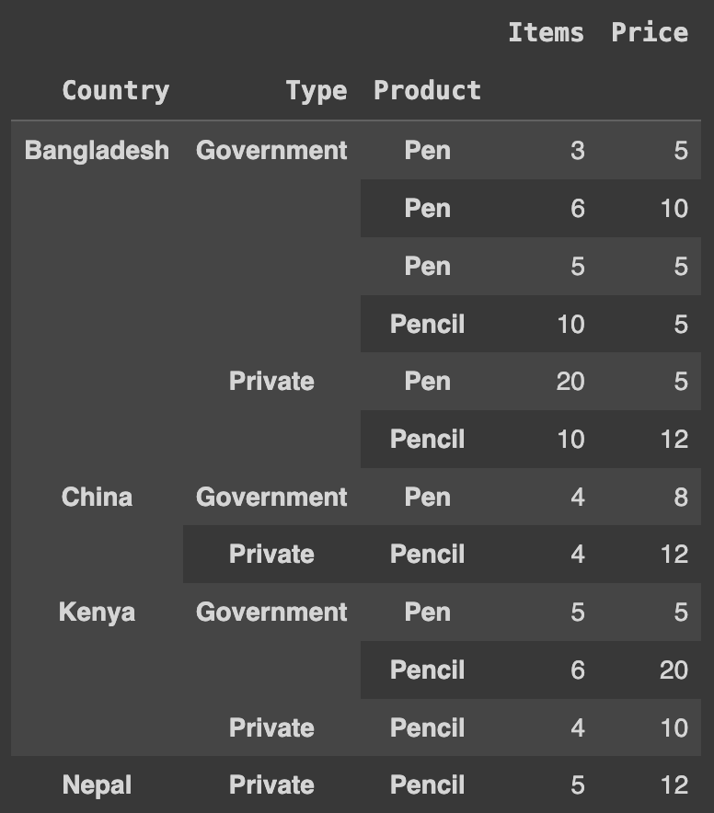
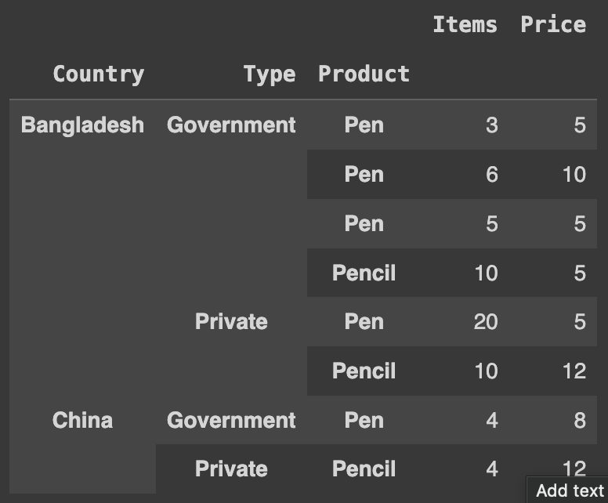
Slicing in Multi-Index
df_ind_sorted['Bangladesh':'China’]

Slide 19
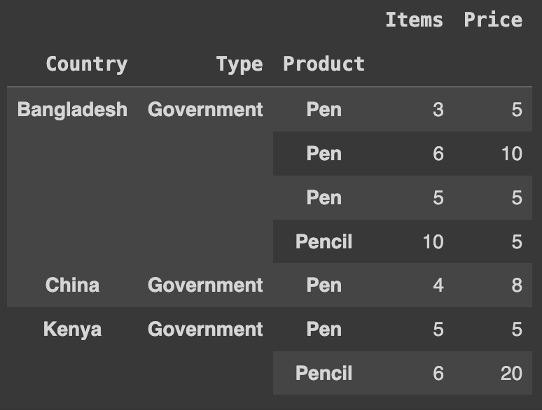
Slicing on Different level
df_ind_sorted.loc[(slice(None), ['Government'], slice(None)), :]

Slide 20
Iterate Multi-Index Dataframe
for idx, data in df_ind_sorted.groupby(level=0):
print('---')
print(idx)
print(data)
# Based on second index
for idx, data in df_ind_sorted.groupby(level=1):
print('---')
print(idx)
print(data)

